Slide 1
HAMR: Rigorous Model-Driven Development
STRESS 2024 – October 24, 2024
Kansas State University
Aarhus University
Robby
John Hatcliff
Jason Belt
Stefan Hallerstede
This material is based on research sponsored in part by DARPA
DISCLAIMER: The views and conclusions contained in this presentation are those of the author and should not be interpreted as representing the official policies, either express or implied, of any agency or department of the U.S. Government, Kansas State University or Aarhus University
Notes:
I'm John Hatcliff, a professor from Kansas State University. This is a second talk on semantics for a modeling language, and here we aim to make deeper connections with the underlying application and infrastructure code via contracts. This talk pulls together several different lines of work that were carried out in collaboration with different teams, including teams from SEI and Galois primarily, but always folks from Collins Aerospace and people working on seL4.

Slide 2
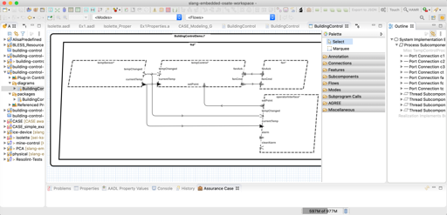
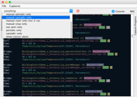
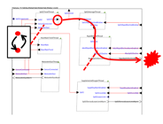
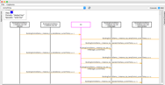
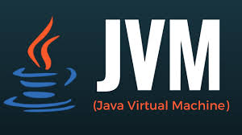

HAMR
HAMR – tool chain for [H]igh [A]ssurance [M]odeling and [R]apid engineering for embedded systems (developed by Kansas State University and Galois)
Leveraging analyses from AADL community
Modeling, analysis, and verification in the AADL modeling language
(+ SysMLv2 Prototype)
Component development and verification in multiple languages
C
Slang (developed at Kansas State)
high integrity subset of Scala
contract verification framework
translates to C
translates to Rust (upcoming)
Rust (upcoming on DARPA PROVERS)
Deployments aligned with AADL run-time on multiple platforms
JVM Deployment
Linux Deployment
seL4 Deployment
verified micro-kernel
Notes:
The framework that we will be using for this work is HAMR -- a model-driven development tool chain for high assurance embedded systems that emphasizes three layers of development:
Modeling, analysis and verification in the AADL modeling language, leveraging many tools in the AADL ecosystem
Development of component application logic in multiple languages include C and Slang (a safety-critical system of Scala with a contract verification framework, which can be translated to C)
Deployments on multiple platforms including seL4 verified microkernel.

Slide 3
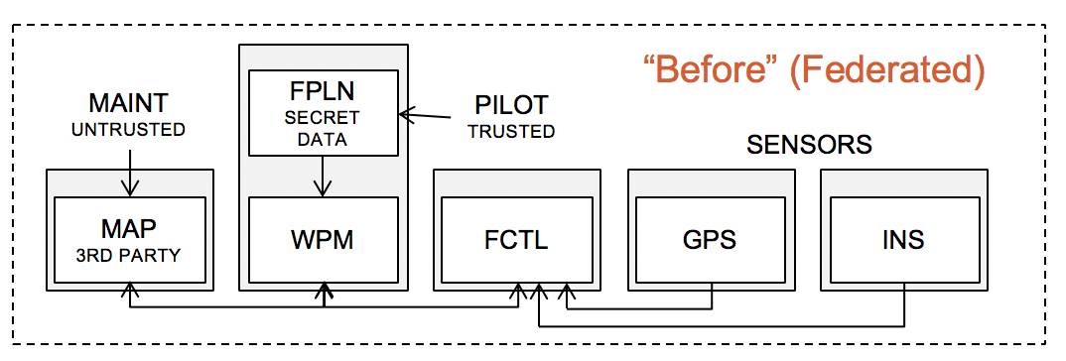
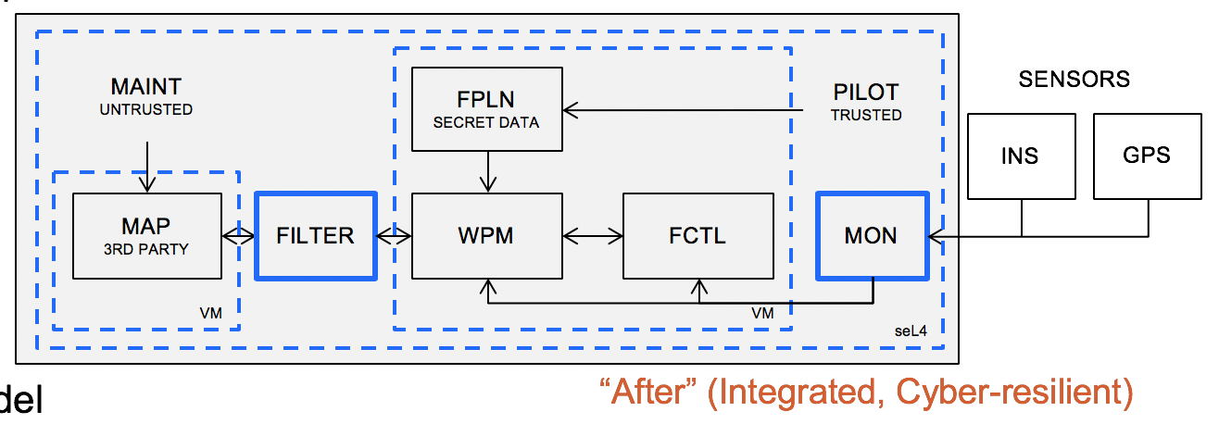
DARPA CASE Approach
HAMR was developed by Kansas State and Galois researchers in a team led by Collins Aerospace on the DARPA CASE project (CASE Goal: Cyber-resiliency of US DoD systems)
Capture requirements for cyber-resiliency
Analyze design
Transform design
Verify new design against requirements
Build / Deploy
Transform
Architecture
Control non-interference by allocating components to different partitions in microkernel
seL4 verified micro-kernel technology is a core technology
HAMR Focus
Wrap legacy untrusted component in a VM in micro-kernel partition
Insert attestation managers to ensure data is coming from a trusted source.
Notes:
[0:30]
HAMR was developed by Kansas State and Galois researchers on a team lead by Collins Aerospace.
The Collins team approach supported
capturing security requirements
automatic analysis of designs
automated transformations
and verification
And HAMR was used to build and deploy systems -- using seL4 to ensure strong partitioning of components and tight control of information flow.

Slide 4
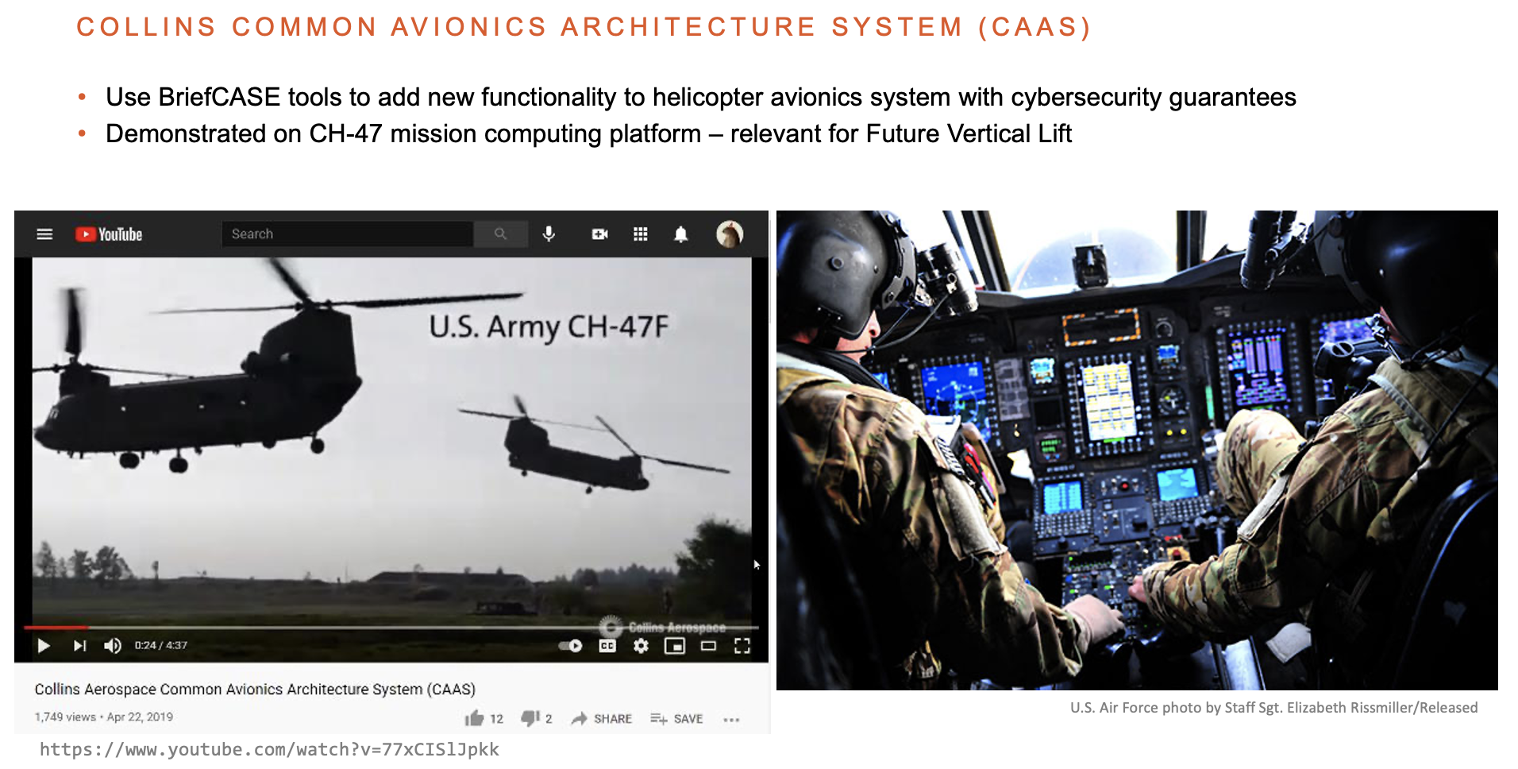

DARPA CASE Final Demonstration
Collins technology stack (including HAMR) used to add new cyber-resilient functionality to CH-47 military helicoptor mission computing...
Notes:
For the DARPA CASE Final Demonstration, the Collins technology stack, including HAMR, was used to add new functionality to a helicopter avionics system with cyber-security guarantees, and this was demonstrated on the CH-47 mission computing platform.
The Collins team has some great videos demonstrating the entire tool chain for this.

Slide 5
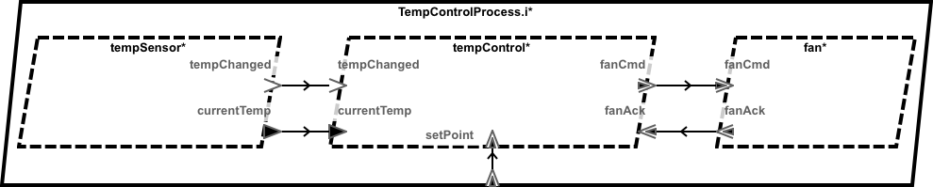
Example
We use a Temperature Controller (thermostat) example to illustrate concepts...
Set Points: Low and High Bounds for Temperature Range (message with payload)
Temperature Changed (Notification Event)
On/Off Command to Fan
(message with payload), e.g., “too hot; turn ON”
Process
Controller
Cooling Fan
Temperature Sensor
(Driver)
Thread (periodic)
Thread
(sporadic)
Thread (sporadic)
Temperature Value (data propagation)
AADL software modeling emphasizes components, component ports (make up an interface), and communication connections between ports
Notes:
AADL computational model [2min]

Slide 6

AADL Modeling Concepts
Developer configures computational structure
AADL Thread Property Options
AADL Port & Connection Property Options
Periodic
Sporadic
Hybrid
…
Event
Data
Event Data
…
buffered notifications
shared data cells (or data distribution service)
buffered messages
(message passing middleware)
+ QoS, buffer sizes, latencies, etc
+ timing, scheduling
constraints, etc.
Code skeleton for selected thread pattern
Implied API Pattern for application code to access port communication, etc.
Implementation of selected communication pattern
...an AADL contract language and testing infrastructure should be aligned with these patterns.
Notes:
[1:00]
Let’s look deeper at how HAMR code generation works.
When you use AADL, your not just drawing boxes and lines.
You’re also using AADL properties to configure the semantics of the modeling elements.
For example, for threads your selecting if you want the thread to be time triggered, event trigger, etc.
For ports, your indicating the communication pattern that you want, size of buffers, etc.
When HAMR generates code, these properties determine the type of threading infrastructure generated,
and the implementation of communication channels.
the type of APIs generated for port communication.
These properties also determine the variant of the run-time services that will be used and for our contract framework, it impacts the structure of the contracts that developers will use.

Slide 7
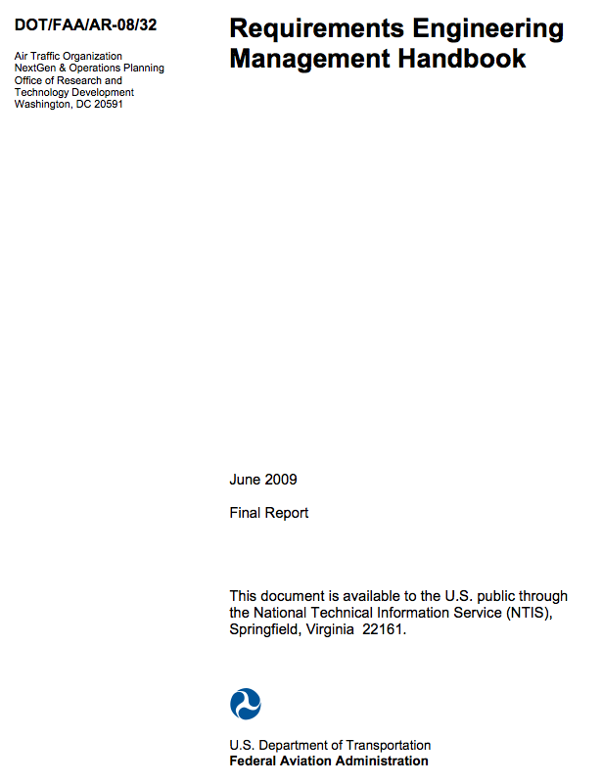
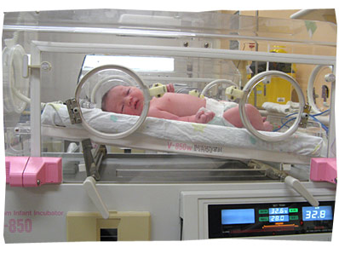
FAA Requirements Engineering Management Handbook (REMH)
Illustrate with a simple infant incubator medical device example from FAA REMH
Handbook on best practices for requirements development written for the FAA by engineers at Collins Aerospace
Includes example of an “Isolette” (infant incubator)
REMH
6 Real-time Tasks
~36 component-level requirements
Interestesting modal behavior
http://www.faa.gov/aircraft/air_cert/design_approvals/air_software/research/

Slide 8
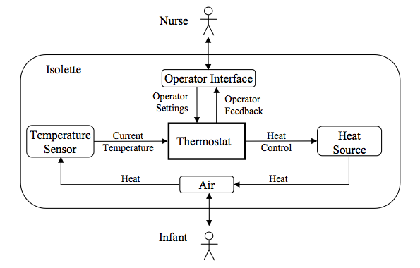
Focus of Example
Isolette Thermostat – heat controller for incubator
Focus of demo

Slide 9
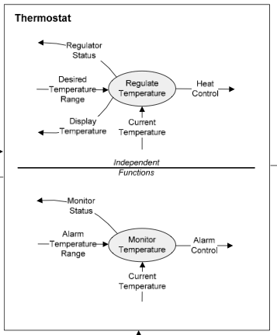
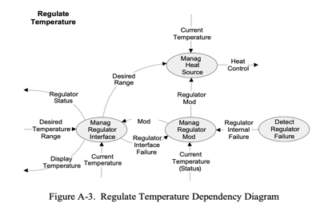
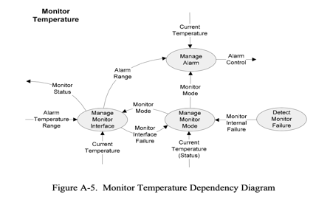
Decomposing Thermostat
The FAA REMH decomposes the Isolette into a control system and safety monitor subsystem with three tasks each
Control/Regulate
Safety Monitor
Thermostat decomposed into Regulate Temperature and Monitor Temperature functions.

Slide 10
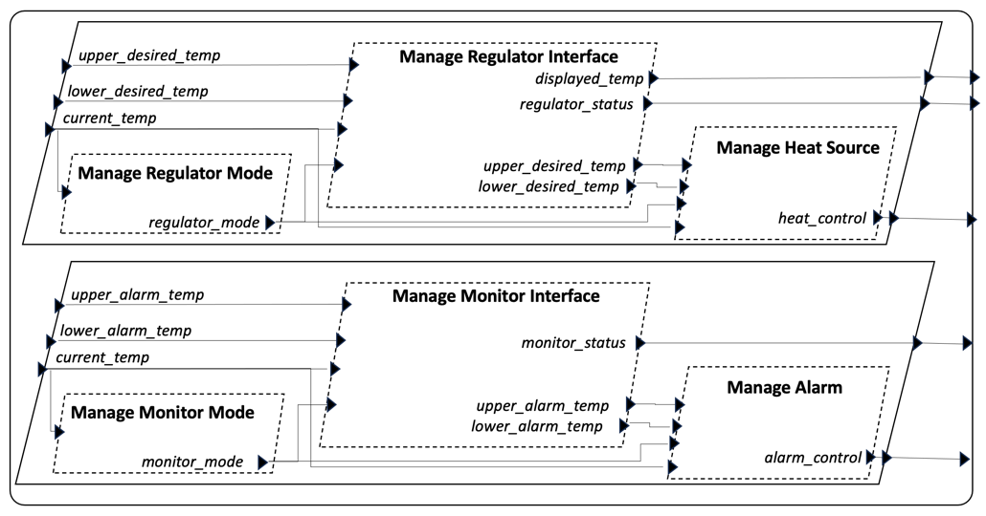
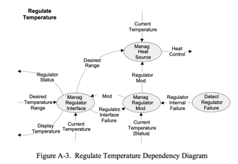

Using AADL to Represent Design
AADL Model is a straightforward rendering of the design diagrams in the FAA REMH
Manage Heat Source Thread (Task)
Informal REMH Design Artifacts
Formal AADL Model
Manage Alarm
-- Illustrate difficulties with testing coverage
This example is worked completely end-to-end from requirements, to contracts, to automatically tested and verified application code, to deployment on seL4, Linux, JVM, JavaScript.
All artifacts are publicly available.

Slide 11
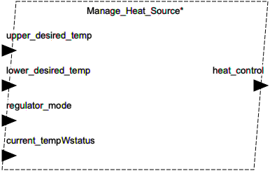
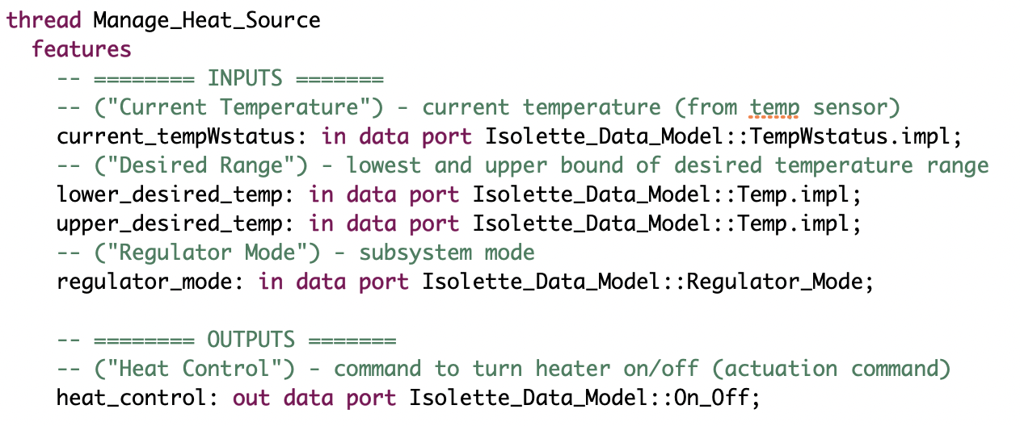
Manage Heat Source Thread
AADL Interface for Manage Heat Source Thread
Desired Temperature Range
(low & high set points)
Desired On/Off state for heater
Subsystem Mode
Current Temperature

Slide 12
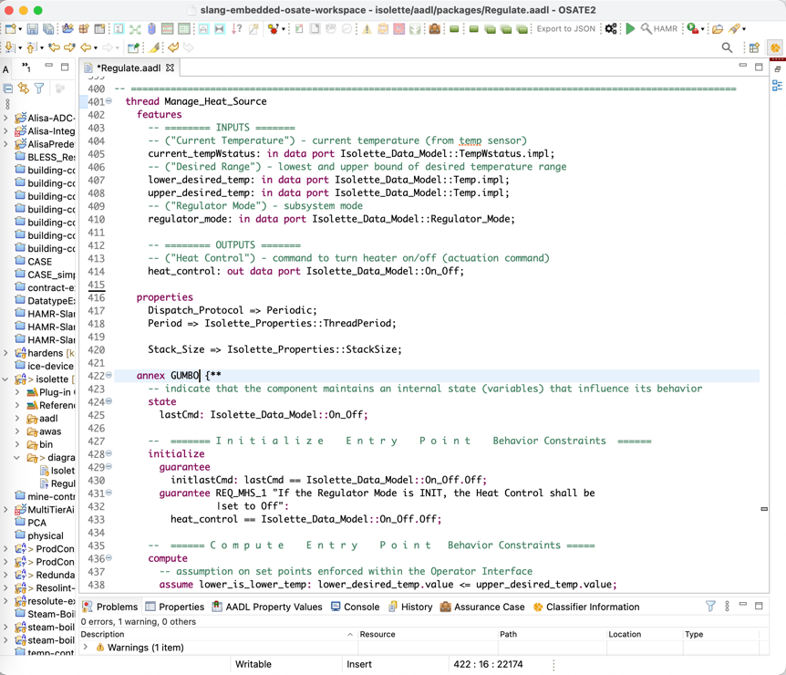
Demo
Isolette AADL model in Eclipse-based OSATE (AADL open source IDE)

Slide 13

HAMR Code Generation
Code gen for Application APIs
Code gen for Component & Threading Infrastructure
Code gen for Communication Infrastructure
Application Code Development
System Build
Application Code
Auto-Generated Run-Time Communication Infrastructure Code for Platform
Application Code
Auto-Generated Run-Time Communication Infrastructure Code for Platform
Application Code
Auto-generated
Component Infrastructure Code for Platform
Auto-generated
Component Infrastructure Code for Platform
Auto-generated
Component Infrastructure Code for Platform
Platform configuration information
Notes:
[1min]
So given these principles, for each thread component, code generation will
[click]
set up threading infrastructure that matches the selected thread dispatch protocol.
Similarly, for each connection, code generation will generate
[click]
a communication pathway that matches the selected communication pattern for the connection.
HAMR will typically generate
[click]
additional platform configuration information.
For example, for seL4, the capDL file and domain schedule are examples of platform configuration information.
What's more relevant for the developer is that HAMR generates a thread skeleton and port APIs for each component. These also hide the details of the particular platform and enable a degree of portability.
Then the developer fills in those skeletons
[click]
and uses the port APIs to code the application logic.
Because you have this well-organized code generation architecture, with different abstraction layers, HAMR can target different architectures pretty easily.

Slide 14
HAMR Code Generation
Code gen for Application APIs
Code gen for Component & Threading Infrastructure
Code gen for Communication Infrastructure
Application Code Development
System Build
Application Code
Auto-Generated Run-Time Communication Infrastructure Code for Platform
Application Code
Auto-Generated Run-Time Communication Infrastructure Code for Platform
Application Code
Auto-generated
Component Infrastructure Code for Platform
Auto-generated
Component Infrastructure Code for Platform
Auto-generated
Component Infrastructure Code for Platform
Platform configuration information
Notes:
So now let's take a look
[click]
at how HAMR helps the developer by generating platform independent APIs for AADL communication and threading.

Slide 15
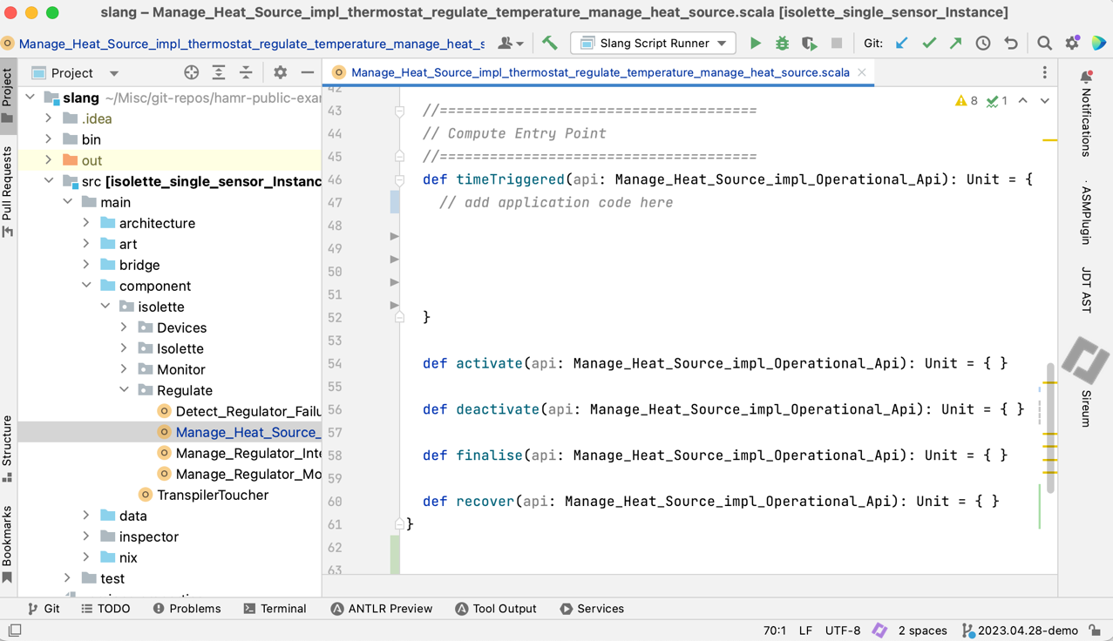
Component Application Code Interfaces Generated from AADL Model
Periodic Thread
w/ data ports
…Interfaces/APIs/Skeletons for application code are auto-generated from AADL model
Skeleton for application code
entry point
AADL Model Implied Semantics
auto-generated
Application Code Skeleton in Slang
Notes:
For Sporadic or event-driven components, HAMR generates the skeleton of a handler method for each incoming event.

Slide 16
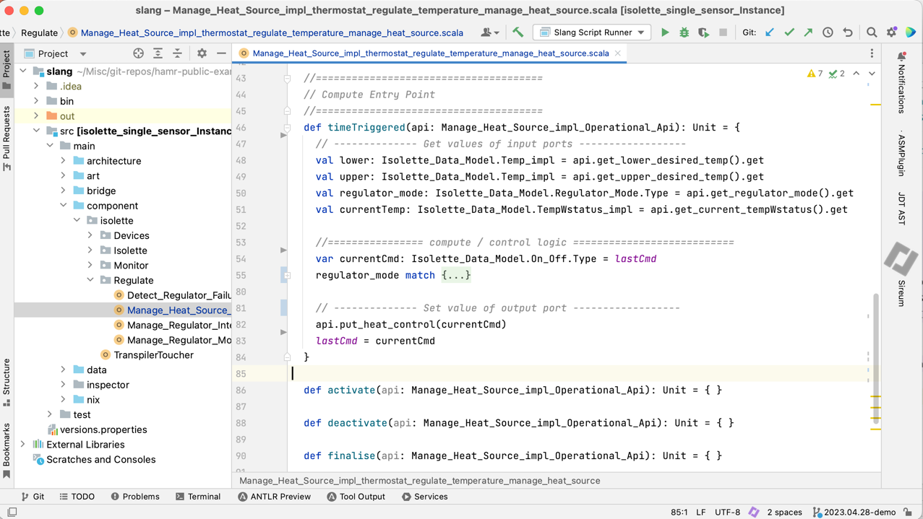
Component Application Code Interfaces Generated from AADL Model
Periodic Thread
w/ data ports
…Interfaces/APIs/Skeletons for application code are auto-generated from AADL model
Adding application code to skeleton
AADL Model Implied Semantics
auto-generated
Application Code Skeleton in Slang
Notes:
For Sporadic or event-driven components, HAMR generates the skeleton of a handler method for each incoming event.

Slide 17
Component Application Code Interfaces Generated from AADL Model
Periodic Thread
w/ data ports
…Interfaces/APIs/Skeletons for application code are auto-generated from AADL model
Put
Get
Reading a value from the regulator_mode input data port using auto-generated API
AADL Model Implied Semantics
auto-generated
Application Code Skeleton in Slang
Putting a value from the heat_control output data port using auto-generated API
Notes:
For Sporadic or event-driven components, HAMR generates the skeleton of a handler method for each incoming event.

Slide 18

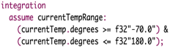
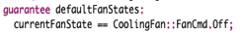
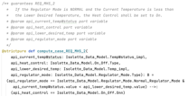
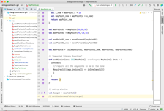
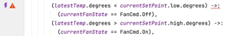
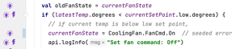
Demo
HAMR code generation and viewing auto-generated skeleton Slang project in Sireum IVE
AADL
Model-Level Contracts
HAMR Code
Generation
Contract Translation
and Embedding / Weaving
Code-Level Executable Contracts + Infrastructure
Slang Component Implementation
Code-Level Logic-based Contracts
Verify via SymExe

Slide 19

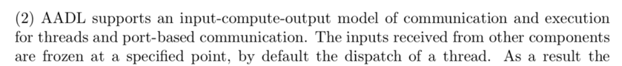
AADL Port and Thread Execution Semantics
“Analyzeable Real-Time Systems” Burns & Wellings
On each dispatch, AADL threads follow a well-known input-compute-output pattern for real-time tasks that simplifies analysis and verification…
(1) Receive inputs
AADL Component Application Memory Boundary
Input Application Port State
Output Application Port State
Application Code
gets
(2) Compute, Run to Completion
puts
Communication Infrastructure - Inputs
Communication Infrastructure - Outputs
From AADL standard…
(3) Send outputs

Slide 20
AADL Port and Thread Execution Semantics
AADL tasking and port semantics ensures no interference with other threads or communication layer
There is no external interference with the application port state while application code executes.
(1) Receive inputs
AADL Component Application Memory Boundary
Input Application Port State
Output Application Port State
Application Code
gets
(2) Compute, Run to Completion
puts
Communication Infrastructure - Inputs
Communication Infrastructure - Outputs
(3) Send outputs
Notes:
[0:45]
Another important thing to understand is that AADL threads, every time that they are dispatched, follow a well-known pattern for real-time tasks that really simplifies analysis and verification.
[click]
First, when the thread is dispatched, behind the scenes, the infrastructure will move inputs from the communication infrastructure into the view of the application code.
[click
Second, the thread runs and can
[click]
[click]
read and write to variables representing ports, but the inputs are frozen while the thread is working,
[click]
Finally, after the work completes, the output is released to the communication infrastructure.
HAMR code generation needs to make sure that these semantics are achieved during code generation.

Slide 21
AADL Port and Thread Execution Semantics
AADL tasking and port semantics ensures no interference with other threads or communication layer
(1) Receive inputs
Abstractly, a function from input ports states (and local data) to output port states (and updated local data)
Input Application Port State
Output Application Port State
Application Code
gets
(2) Compute, Run to Completion
puts
Communication Infrastructure - Inputs
Communication Infrastructure - Outputs
From AADL standard…
(3) Send outputs
Notes:
[1:00]
Now let’s dig a bit deeper into the semantics. On each dispatch AADL threads follow a well-known pattern for real-time tasks that really simplifies analysis and verification.
[click]
First, when the thread is dispatched, behind the scenes, the infrastructure will move inputs from the communication infrastructure into the view of the application code.
[click
Second, the thread runs and can
[click]
[click]
read and write to variables representing ports, but the inputs are frozen while the thread is working,
[click]
Finally, after the work completes, the output is released to the communication infrastructure.
HAMR code generation needs to make sure that these semantics are achieved during code generation.

Slide 22

AADL Port and Thread Execution Semantics
Key idea: contracts are relations on input port state, local variables, and output port states
Contract for application code methods
Local State Variables V
A_{in}
A_{out}
Application Code
gets
puts
Communication Infrastructure - Inputs
Communication Infrastructure - Outputs
Notes:
[0:45]
Another important thing to understand is that AADL threads, every time that they are dispatched, follow a well-known pattern for real-time tasks that really simplifies analysis and verification.
[click]
First, when the thread is dispatched, behind the scenes, the infrastructure will move inputs from the communication infrastructure into the view of the application code.
[click
Second, the thread runs and can
[click]
[click]
read and write to variables representing ports, but the inputs are frozen while the thread is working,
[click]
Finally, after the work completes, the output is released to the communication infrastructure.
HAMR code generation needs to make sure that these semantics are achieved during code generation.

Slide 23
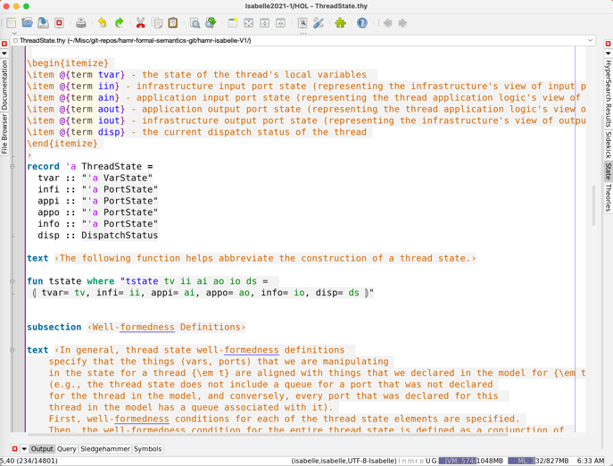
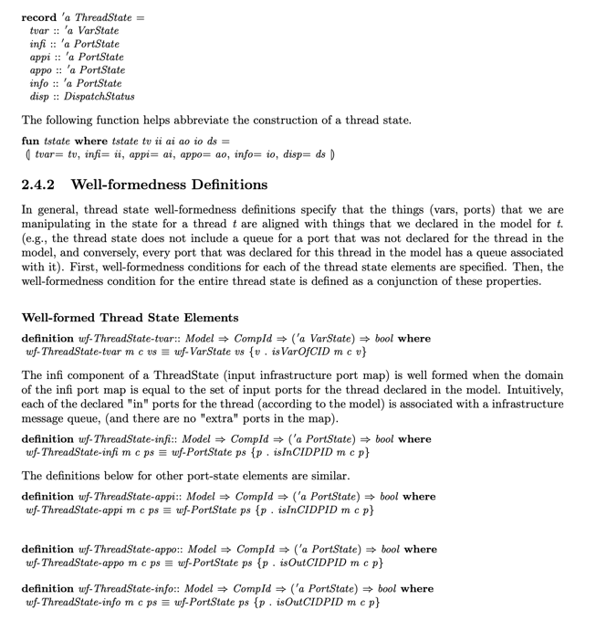
AADL / HAMR Formal Semantics
100+ page literate-style Isabelle/HOL theories for AADL/SysMLv2 HAMR execution model (guides our design of our contracts and verification/testing framework)
Joint work with Stefan Hallerstede (U. Aarhus)
Isabelle
Presented at “Formal Aspects of Component Software (FACS)” conference in October 2023.
Latex/PDF generated from Isabelle

Slide 24
Application: Integrated Model/Code Contract Language
KSU / Galois - US Army research project (SBIR Phase II)...
AADL
Model-Level Contracts
HAMR Code
Generation
Contract Translation
and Embedding / Weaving
Slang Component Implementation
Code-Level Logic-based Contracts
Verify via SymExe
Slang C Transpiler
John Hatcliff, Danielle Stewart, Jason Belt, Robby, August Schwerdfeger, “An AADL Contract Language Supporting Integrated Model- and Code-Level Verification”, (HILT 2022) – (journal version submitted)
Verified C Component Implementation
Notes:
------ (transition) [10sec]
Alright, let's look at how the semantics has guided our design of this
contract framework
------ (framework overview) [1:20sec] [1:30 section total]
This work was done in collaboration with Adventium Labs, which is now
part of Galois.
The idea is that in addition to the model-base code generation that
HAMR already does, we want to have an AADL contract language, aligned
with our AADL semantics that we can use to verify model level
properties. But we also want to be able to generate contracts to
accompany the user's component application code, and verify by
symbolic execution that the component code conforms to the contracts
at both the code and model level.
To enhance the useability and utility of the contracts, we also
generate execute contracts and infrastructure that enables automated
randomized testing against the contracts.
Now I am going to focus my story on Slang, but note that there are a
couple of workflows that tie into C. First, we can write our
component in Slang, verify it and then translate to C to get a
verified C component implementation. Or we can write the the
component code in C and then test it against auto-generated
property-based testing framework, which we translate from Slang into
C.

Slide 25
Application: Integrated Model/Code Contract Language
Motivation for adding contract-based testing…
AADL
Model-Level Contracts
Scalability for large/complex components (e.g., SMT timeouts for Float-32)
Can still leverage contracts via testing when SMT-based verification is struggling)
Familiar testing-based workflows
Testing-based assurance evidence integrates easily with existing industry processes and certification
Counter-examples: Contract violations are failing tests which are easy for developers to run through the debugger
Multi-use: leverage contracts for unit testing, unit SMT-verification, run-time monitoring…
HAMR Code
Generation
Contract Translation
and Embedding / Weaving
Slang Component Implementation
Code-Level Logic-based Contracts
Verify via SymExe
Slang C Transpiler
Verified C Component Implementation
Notes:
------ (transition) [10sec]
Alright, let's look at how the semantics has guided our design of this
contract framework
------ (framework overview) [1:20sec] [1:30 section total]
This work was done in collaboration with Adventium Labs, which is now
part of Galois.
The idea is that in addition to the model-base code generation that
HAMR already does, we want to have an AADL contract language, aligned
with our AADL semantics that we can use to verify model level
properties. But we also want to be able to generate contracts to
accompany the user's component application code, and verify by
symbolic execution that the component code conforms to the contracts
at both the code and model level.
To enhance the useability and utility of the contracts, we also
generate execute contracts and infrastructure that enables automated
randomized testing against the contracts.
Now I am going to focus my story on Slang, but note that there are a
couple of workflows that tie into C. First, we can write our
component in Slang, verify it and then translate to C to get a
verified C component implementation. Or we can write the the
component code in C and then test it against auto-generated
property-based testing framework, which we translate from Slang into
C.

Slide 26

Application: Integrated Model/Code Contract Language
This paper adds automated unit-testing using executable contracts as oracles..
AADL
Model-Level Contracts
HAMR Code
Generation
Contract Translation
and Embedding / Weaving
Code-Level Executable Contracts + Infrastructure
Slang Component Implementation
Code-Level Logic-based Contracts
Verify via SymExe
Automated property-based testing
Slang C Transpiler
Slang C Transpiler
C executable contracts and property-based testing infrastructure
Verified C Component Implementation
Handwritten C component code with automated testing
Notes:
------ (transition) [10sec]
Alright, let's look at how the semantics has guided our design of this
contract framework
------ (framework overview) [1:20sec] [1:30 section total]
This work was done in collaboration with Adventium Labs, which is now
part of Galois.
The idea is that in addition to the model-base code generation that
HAMR already does, we want to have an AADL contract language, aligned
with our AADL semantics that we can use to verify model level
properties. But we also want to be able to generate contracts to
accompany the user's component application code, and verify by
symbolic execution that the component code conforms to the contracts
at both the code and model level.
To enhance the useability and utility of the contracts, we also
generate execute contracts and infrastructure that enables automated
randomized testing against the contracts.
Now I am going to focus my story on Slang, but note that there are a
couple of workflows that tie into C. First, we can write our
component in Slang, verify it and then translate to C to get a
verified C component implementation. Or we can write the the
component code in C and then test it against auto-generated
property-based testing framework, which we translate from Slang into
C.

Slide 27
GUMBO – AADL Contract Language
GUMBO Contract Language Features
Data type invariants
Port invariants (integration constraints)
Event-based / Shared-data based inter-thread communication
Local state declarations with invariants
Pre/Post conditions for AADL thread code entrypoints
Initialize Entry Point
Compute Entry Point
Periodic
Sporadic (collection of event handlers)
Support for fixed-width scalars (e.g., Float32)
Support for almost all of the AADL Data Modeling Annex (enums, records, arrays, etc.)
Inspired by previous work on AGREE (Collins Areospace) and BLESS
Example in this talk
John Hatcliff, Danielle Stewart, Jason Belt, Robby, August Schwerdfeger, “An AADL Contract Language Supporting Integrated Model- and Code-Level Verification”, (HILT 2022) – (journal version submitted)

Slide 28

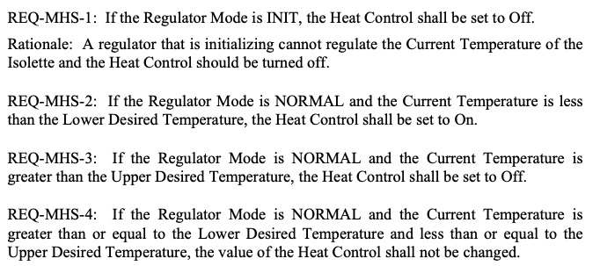
Requirements to Contracts
FAA REMH requirements for Manage Heat Source task
Requirements for control laws of this task...

Slide 29
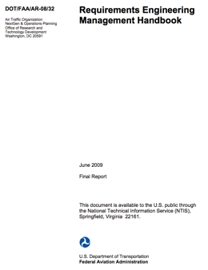

Requirements to Contracts
GUMBO contracts are written together with the thread interface in the AADL OSATE IDE (using AADL Annex clause)
Component interface
Developer formalizes requirements
Component contract

Slide 30
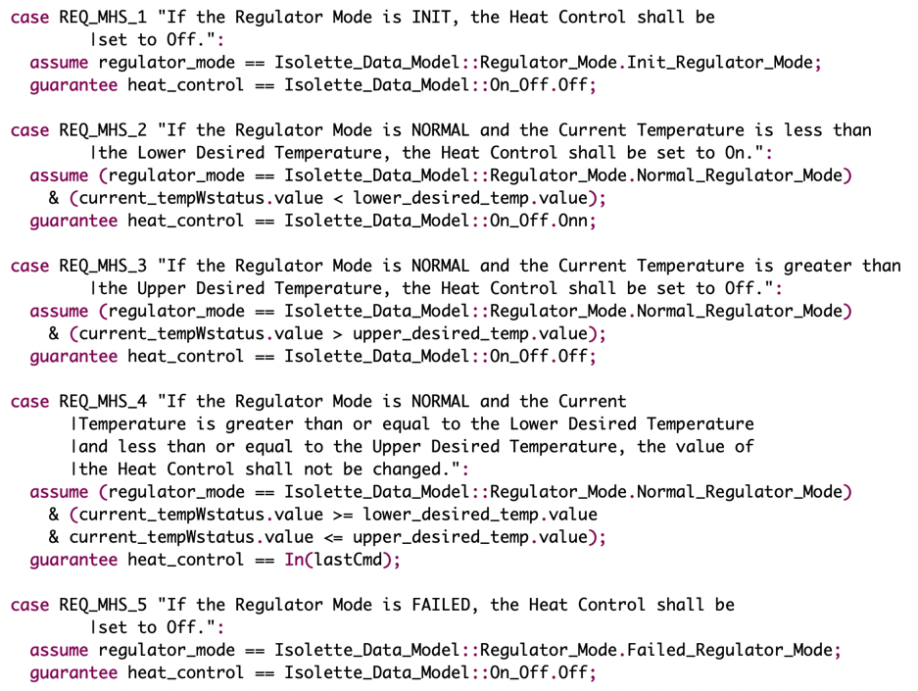

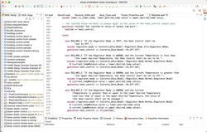
Manage Heat Source Contracts
AADL GUMBO Contracts for Manage Heat Source Thread, with traceability to REMH requirements.
Developer formalizes requirements
OSATE AADL Editor

Slide 31
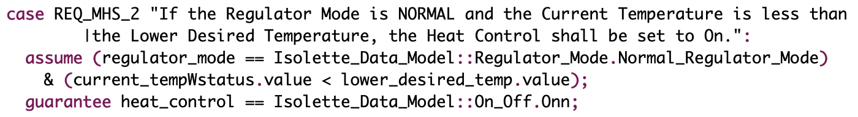
Manage Heat Source Contracts
AADL GUMBO Contracts for Manage Heat Source Thread, with traceability to REMH requirements.
Compare current temperature to desired range
Mode condition
...
...
Set the desired state of the heater
OSATE AADL Editor

Slide 32
Application: Usable, Workflow Integrated Verification
KSU / Adventium Labs (now Galois) DARPA SBIR Phase II...
AADL
AADL-Level Contracts
HAMR Code
Generation
Contract Translation
and Embedding / Weaving
Code-Level Logic-based Contracts
Code-Level Executable Contracts
Slang Component Implementation
Verify via SymExe
Check via property-based testing
Next: Integrated Verification via Symbolic Execution

Slide 33
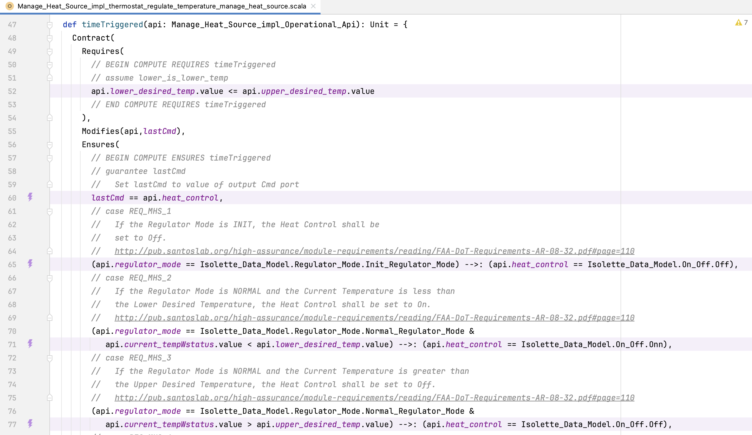
Automatically Embedded Slang Logical Contracts
Verification against contracts using Logika tool (Symbolic Execution)
HAMR automatically translates AADL contracts into code-level Slang contracts.

Slide 34
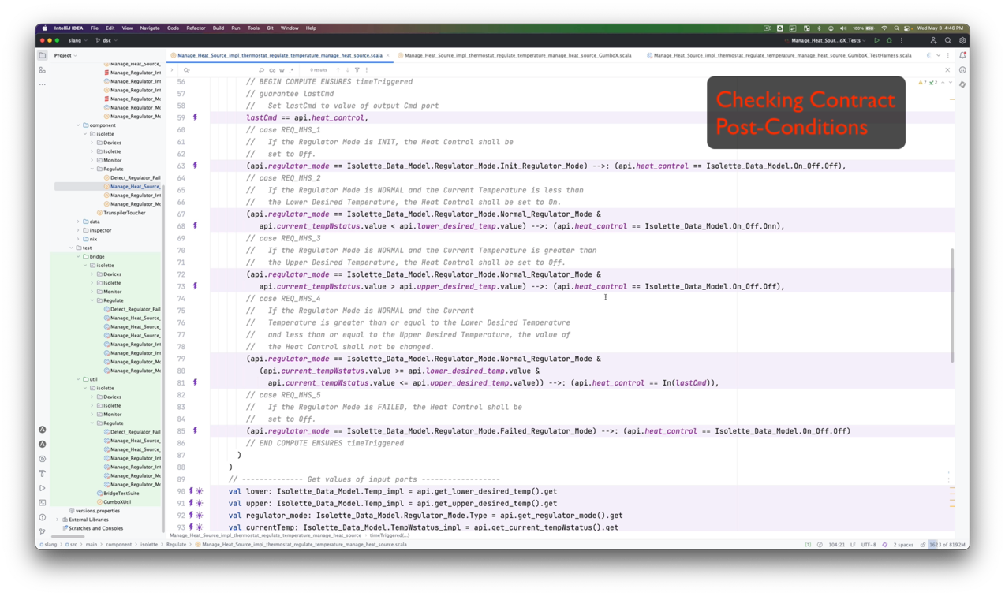
Student Activity
Verification against contracts using Logika tool (Symbolic Execution)

Slide 35
Application: Property-based (Contract-based) Testing
KSU / Adventium Labs (now Galois) ARMY SBIR Phase II...
AADL
AADL-Level Contracts
Next: Property-based Testing with Random Values
HAMR Code
Generation
Contract Translation
and Embedding / Weaving
Code-Level Logic-based Contracts
Code-Level Executable Contracts
Slang Component Implementation
Verify via SymExe
Check via property-based testing

Slide 36
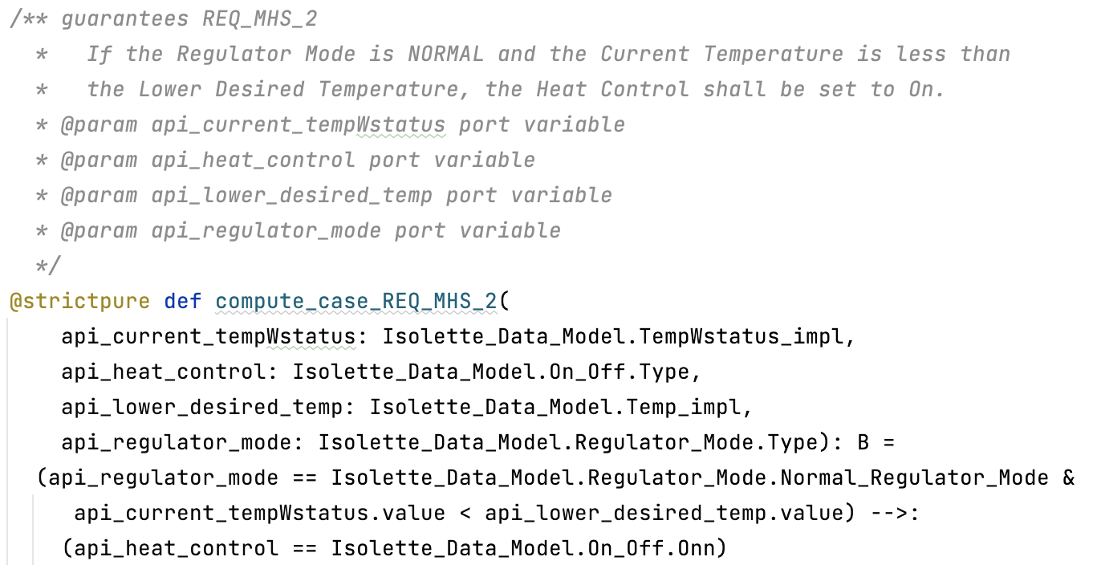

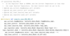
Manage Heat Source Contracts
Each clause in model-level GUMBO contracts is translated to a code-level Boolean function in Slang that works on the appropriate port/thread state elements
AADL GUMBO Contract (clause)
Model
Slang Executable Contract (clause)
auto-generated
auto-generated
Traceability info automatically embedded
Application Code
Code
Library of Executable Contracts

Slide 37
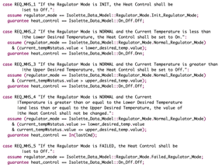
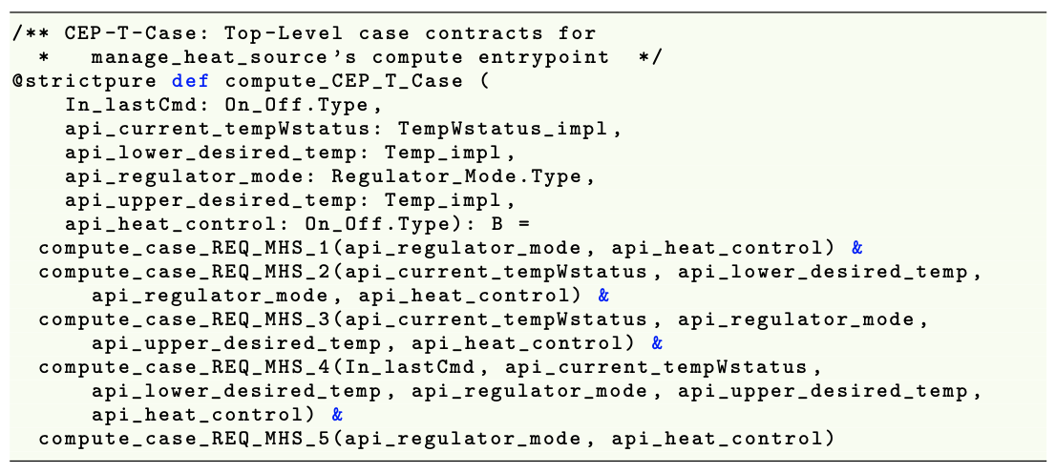
Manage Heat Source Contracts
Complete Model-level GUMBO contracts are translated to a hierarchy of executable Boolean functions in Slang (code-level)
Model: AADL GUMBO Contract (all five clauses)
Code generation weaves together functions for contract clauses to form a pre-condition checker and a post-condition checker (also includes data invariants, etc.).
Model
(see paper for details)
Code: Auto-generated in Testing Library
Slang Executable Contract (aggregated clauses for post-condition)
auto-generated
auto-generated
Application Code
Code
Library of Executable Contracts

Slide 38

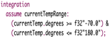

Auto-Generated Property-based Testing Harness
For every thread component, HAMR auto-generates property-based testing infrastructure for inserting values into component input ports and for checking values of output ports.
Models & contracts
Automated:
Start with a push-button experience for the user
Executable Contracts
HAMR-generated AADL Thread Infratructure
Gen(T₁)
Thread
Application
Code
Gen(T₂)
Gen(T₃)
Default random value generators for each input port (based on port type and data invariants)
X₁, X₂, ..., X_{n}
Integrated
Pre-condition
Checker
Function
Integrated
Post-condition
Checker
Function
Repeatedly dispatch with random values and check post-condition
Customize as necessary

Slide 39
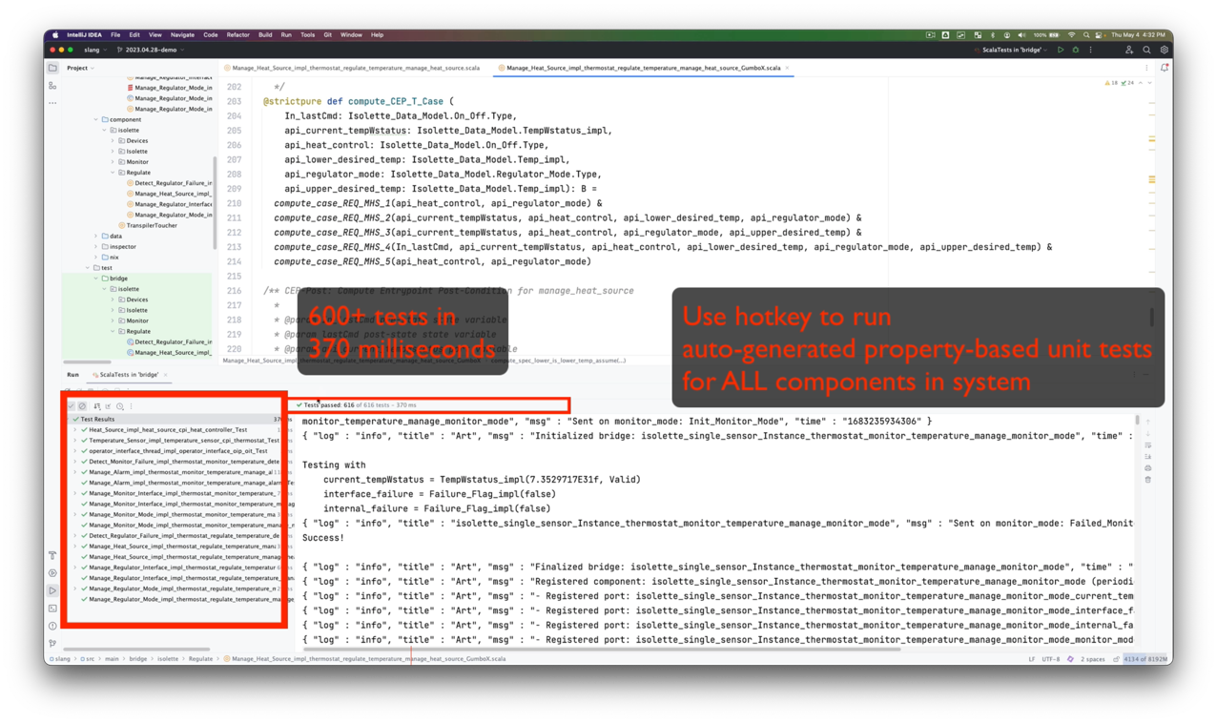
Demo
Property-based Testing

Slide 40
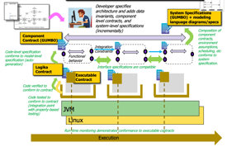

Scaling Up – Server-Based Deployment
HAMR generates a server-based deployment to run the framework in a distributed/parallel fashion...
Parallelization
Servers
...
...
...
Distribution
...
Continous Integration / Delivery of Formal Methods
Map/Reduce Structure for Server-based Deployment of Contract-based Testing
Random generators and contract-based tests are farmed out to a configurable family of servers
Test vectors and results are serialized for flexible deployment, reporting, and replay of the tests
Currently hosted using our Jenkins setup, but easy for HAMR to automatically generate deployment scripts, e.g., for AWS, in the future

Slide 41
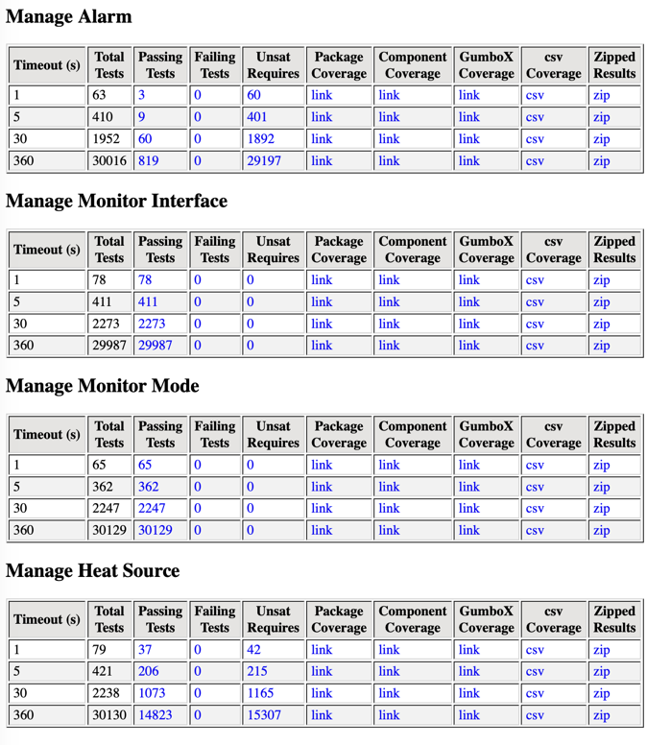
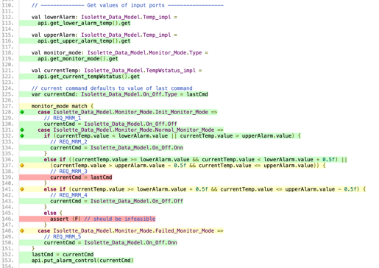
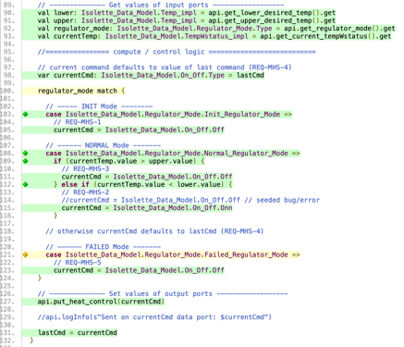
Automatically Generated Test Reports
HAMR’s server-based testing framework generates a collection of hyper-linked reports (good fodder for assurance case evidence)
Linked coverage reports
See paper for summary of experiments:
Isolette
Temperature Control (event-based)
Nuclear Reactor Trip System
...

Slide 42
Exercise
This exercise will consider the Manage Regulator Mode component
…src/main/component/isolette/Regulate/Manage_Regulator_Mode_impl

Slide 43
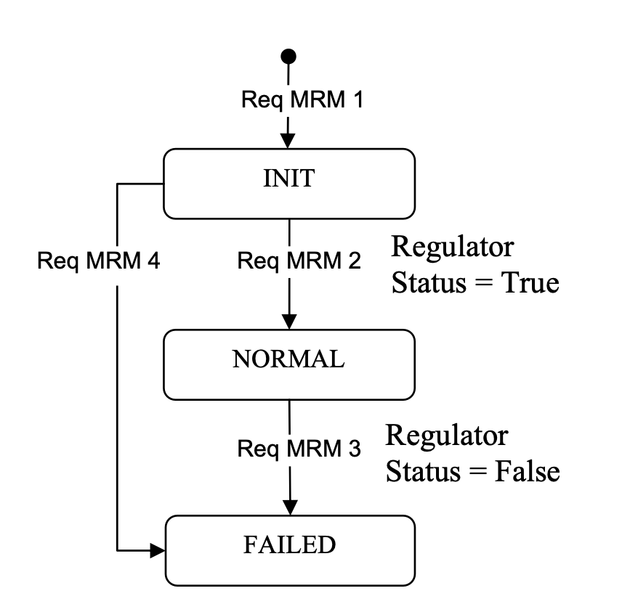
Exercise
Below is a diagram from the FAA Requirements Engineering Management Handbook indicating the desired mode transitions implemented by the component. The component code currently has two bugs. Correct the implementation so that the component contract is satisfied.
If Regulator State = False..
(Hint: maybe some code is missing)
(Hint: maybe some code wrong)
…src/main/component/isolette/Regulate/Manage_Regulator_Mode_impl

Slide 44


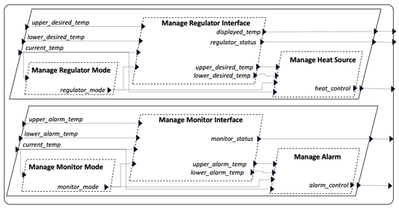



Run-Time Monitoring
Run-Time Monitoring of GUMBO Component Contracts
…bonus content:
done after FMICS submission
Each trace step represents a task dispatch
(e.g., slot in static schedule for seL4 as used on DARPA CASE)
...
...
Database/log of serialized port states
...currently being extended for directed / randomized system testing and temporal properties
Contract Status Reporter
Port Value Visualizer

Slide 45

Trace State Visualization
HAMR automatically generates support for viewing current port values at each step in execution trace (run-time monitoring or system testing) or post-facto viewing of trace logs..
...
...
Similar to “watch variables” in a debugger but at an abstraction level associated with AADL dispatch semantics

Slide 46


Contract Checking Status
HAMR automatically generates dynamic report on the status of each contract, and provides infrastructure for unit test replays of code that violates contracts
...
...
saved component input state
Using serialized state, HAMR can automatically generate unit tests suites for replaying failing behavior at the unit level for easy debugging.

Slide 47


Resources
Publicly available tool:
http://hamr.sireum.org
Resources on HAMR web site
Distribution available for Windows, Linux, and Mac (also virtualized) hamr.sireum.org
Documentation, examples, and tutorial material for HAMR
Educational resources -- slides, recorded lectures, and guided exercises for HAMR Slang back end
Online textbook for Slang/Logika available later this fall
Notes:
In conclusion, HAMR helps support DARPA CASE goals by adopting multiple design goals that emphasize compositionality
– leading to a rich model-based systems engineering framework that supports multiple deployment platforms and multiple implementation languages
– while also emphasizing assurance other other rigorous development practices
For more information, check out the HAMR site, which includes the distribution, along with documentation and a really good collection of educational resources.

